Slide 1



GraphQL: A Modern Approach to APIs
GraphQL is a query language and runtime for APIs. It provides a flexible and efficient way to fetch data from your backend.
by Surya

Slide 2
GraphQL vs. REST
GraphQL
REST
GraphQL is a query language that allows you to specify exactly the data you need. It is strongly typed, which makes it easier to build robust applications.
REST is a widely used architectural style for APIs. It relies on HTTP verbs like GET, POST, PUT, and DELETE to interact with data.

Slide 3
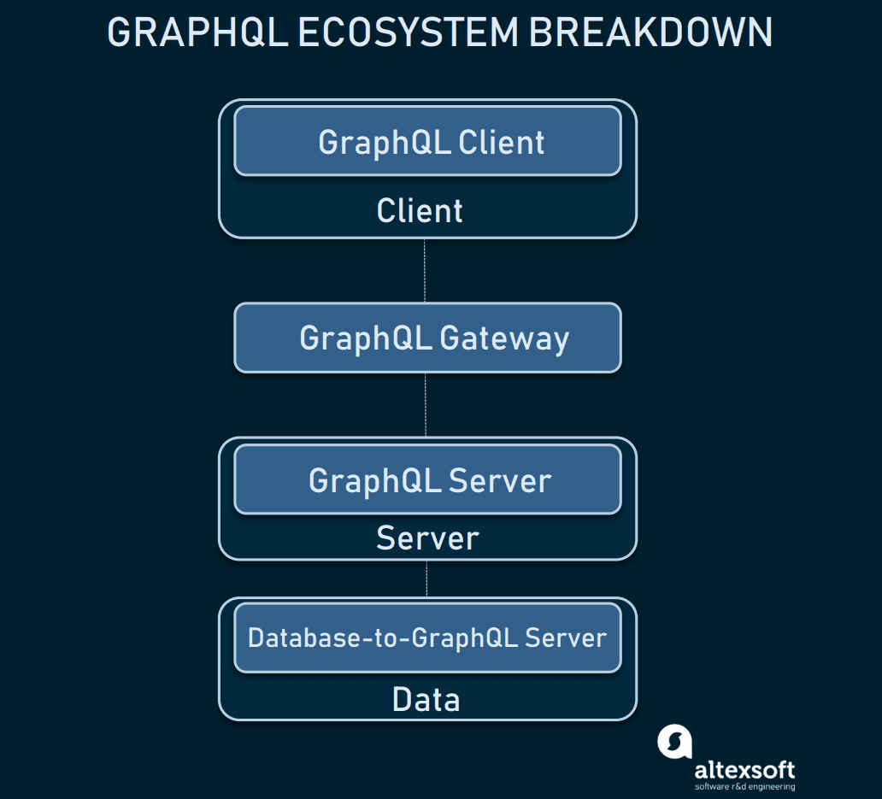

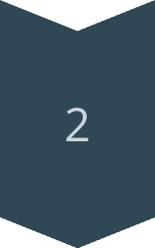
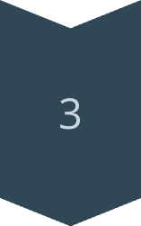
GraphQL Architecture
Client
The client sends a GraphQL query to the server.
Server
The server receives the query, parses it, and executes it against the schema.
Resolvers
Resolvers are functions that retrieve data from the database or other sources.

Slide 4
GraphQL Query Language
Fields
Arguments
Nested Queries
GraphQL queries specify the fields you want to retrieve from the data.
Arguments allow you to filter and sort the data you are fetching.
You can use nested queries to fetch related data from multiple resources.

Slide 5
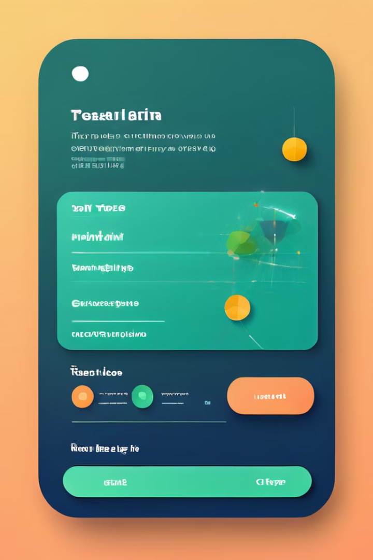
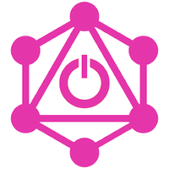
GraphQL Mutations
1
Create
2
Update
Mutations allow you to create new data in your database.
Mutations allow you to update existing data in your database.
3
Delete
Mutations allow you to delete data from your database.

Slide 6

GraphQL Resolvers
Resolvers
Functions that fetch data for each field in a GraphQL schema.
Data Sources
Connect to databases, APIs, or other data sources.
Mapping
Map data from the source to the GraphQL schema's types.

Slide 7
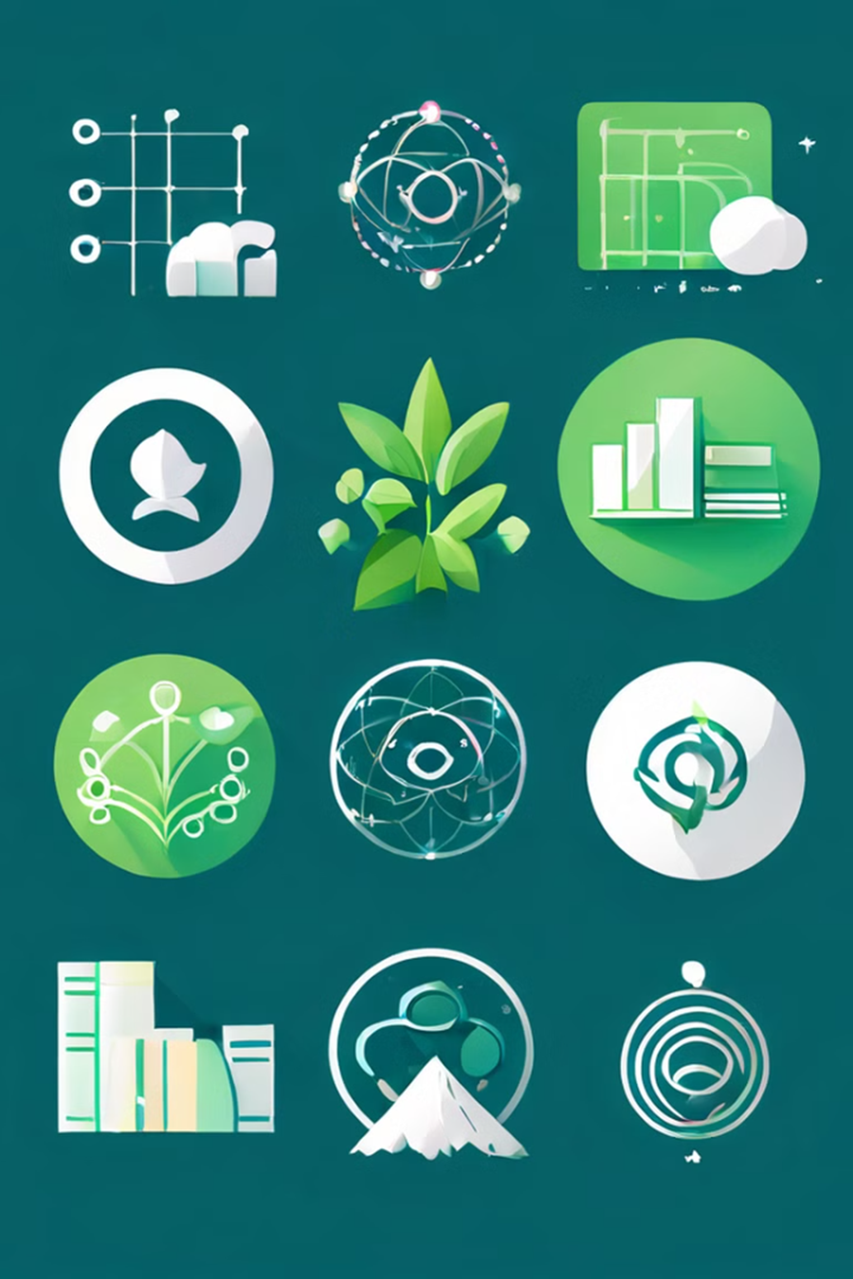
Why Use GraphQL?
Advantages:
Avoid over-fetching and under-fetching of data.
Improved performance with fewer network requests.
Strongly-typed schema allows better documentation and tooling.
Real-time data updates with subscriptions.

